Slide 1
D-Lab Presents:
RStudio Project Management
Evan Muzzall
Digital Humanities Working Group Presentation 03/07/2019

Slide 2
Data science projects consist of:
Themes
Domain expertise
Teams
Many components to a project!
Tools
Data importation and preprocessing
Timelines
Assign roles/responsibilities for each part (or, how will you manage them all by yourself?)
Documentation, presentation
Research question/hypotheses, framework
Data
Visualization and analysis
Staying organized (.Rproj files)
Documentation (Rmarkdown)
Collaboration (Bash + GitHub)

Slide 3

How to manage your project
Store the constituent parts of your project inside of a .Rproj file as a sort of self-contained “repository”. Manage it using RStudio!
Include in the main directory: Readme, license, software requirements, coding scripts, subdirectories
Subdirectories for: Inbound data, output, documentation, figures, images, text, version info

Slide 4
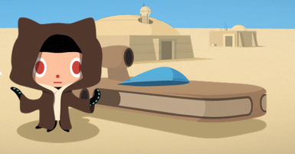
Repository organization
1-introduction: PowerPoint slidedeck
2-RMarkdown: SAT score example; code for data import, clean, viz, and test
3-html:
4-ioslides:
5-shiny:
Readme:
License: choose a license for your work. For teaching, MIT License is usually a good choice for fair use
TODO:
Inbound data/ this is where we will save the raw data
Output/ results of statistical tests live here
Figures/ visualizations live here
Tables/ save tables here
Docs/ save slides here, along with

Slide 5
Connect to GitHub

Slide 6
Example: 2012-2013 SAT test takers
Open 2-markdown.Rmd (link) in Rstudio to follow along
Import data from here: https://catalog.data.gov/dataset/sat-school-participation-and-performance-2012-2013
Walkthrough examples using RMarkdown
Add to GitHub repository from:
1) command line and
2) RStudio interface,
3) share with your neighbor

Slide 7
Tutorials to get started (asana, gsuite, qualtrics)
Research design
Research question, literature review, hypotheses, statistical framework, fread
Data methods and tools
Importation
Preprocessing
Visualization
Statistics
Inferential Thinking (Python)
MS Excel
Document preparation
RMarkdown (.Rmd)
.html
MS Word
.pdf
Presentation
Ten rules for structuring papers
MS Powerpoint
Omeka
slideshows
Shiny
Organization
Google Drive
RStudio Projects
Dependency management
Collaboration
GitHub
ssh
Jupyter Notebooks

Slide 8
Containers (virtual machines)
Do you need to run a particular version of a program? Learn more about:
Academic Environments on Demand
Virtual Box
You might also need to package these version configurations as reproducible environments along with your data and code. If so, check out:
Docker, Kubernetes, etc. (Medium freeCodeCamp)

Slide 9
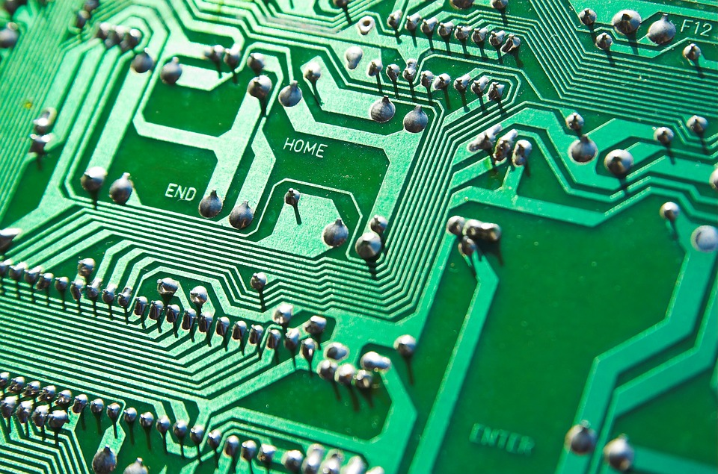
High Performance Computing
Click the links below to learn more about accessing greater compute power, memory, and storage:
Benten?
Savio
XSEDE
Bridges
Jetstream

Slide 10

Other resources
Asdf
Asdf;lkj
Make files
Travis CI
Bash
Bookdown
R package tutorial / Pkgdown
Overleaf (LaTeX)

